Slide 1
Belle Haven Elementary Reimagined
February 22nd, 2023

Slide 2
Executive Summary
We are working on the design for a $50m reimagined Belle Haven, the first major campus upgrade since the 1960s.
The initial design calls for six new classrooms, modernizing 18 classrooms, a new student supports building, a new full sized gym, and a new playground.
The focus of today is the possibility to consider possible changes to the field to the north of the school to make that space even more accessible and beneficial to the Belle Haven community.
We are planning on renovating the school classrooms beginning January 2024 and would not begin major work on the field area until Summer of 2026. During construction the field is (likely) to be needed as swing space.

Slide 3
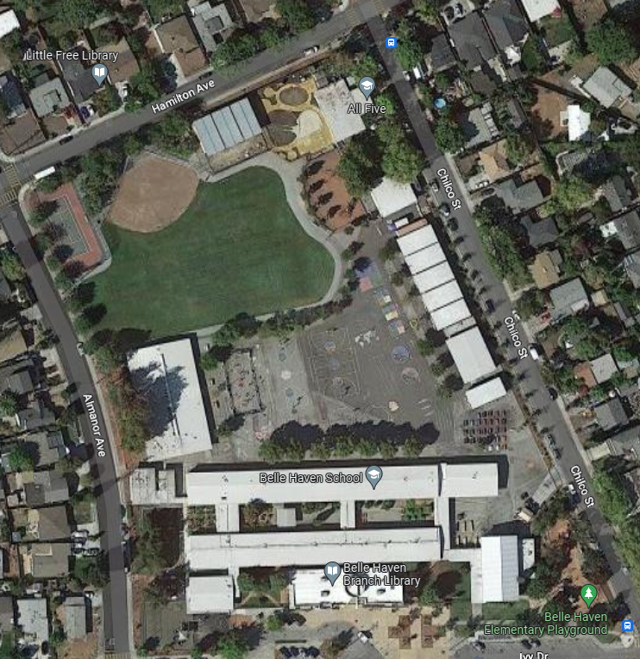
Current Site There are a number of issues with our current site that we are hoping to address with our revised design
Issues we’ve heard from the community
It is difficult to access the field. There is no clear community entrance to the field and no designated seating on the field.
Relatively limited shade on the field (and none on the blacktop).
A slightly awkward overlap between the baseball field and tennis courts, and an unusually shaped field.
A field that uses over millions of gallons of water annually.
The current gym is located far from the community entrance to the field and is under-sized. Accessing the gym also gives access the core campus.
Publicly inaccessible black-top space behind the school.

Slide 4
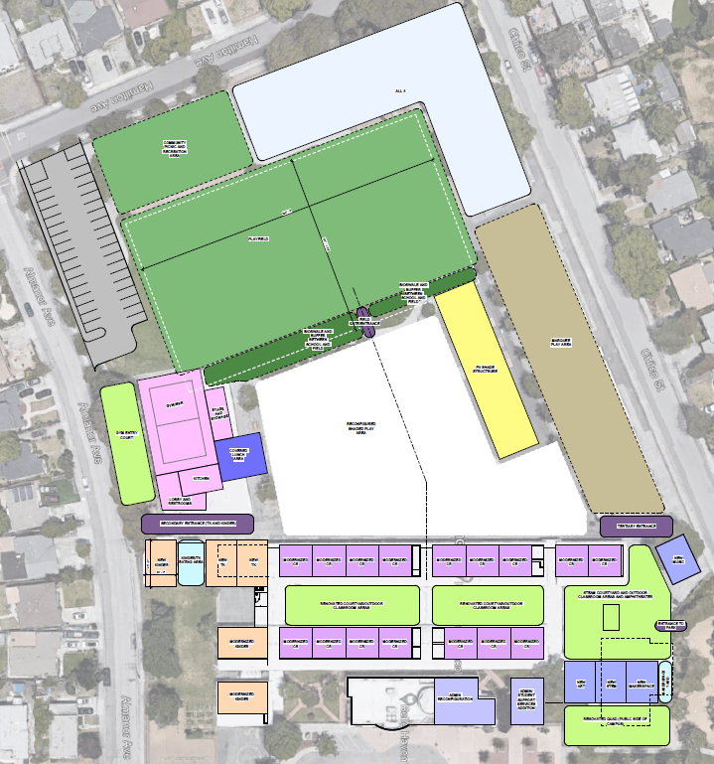
Preliminary Campus Design Our proposed initial design addresses many of the issues that we’ve heard with the site
Focus of today’s conversation

Slide 5
Preliminary Campus Design We are not presenting final designs – more options for conversation
While the campus designs are settling into place, the designs for the field are in earlier stages
The goal of these designs is to show pieces in place without focusing on the many aspects that will come in the final design (such as additional trees)
This area is the last to be built; while we need to submit some preliminary designs with the campus, we will have significantly more time to finalize the design for this space

Slide 6
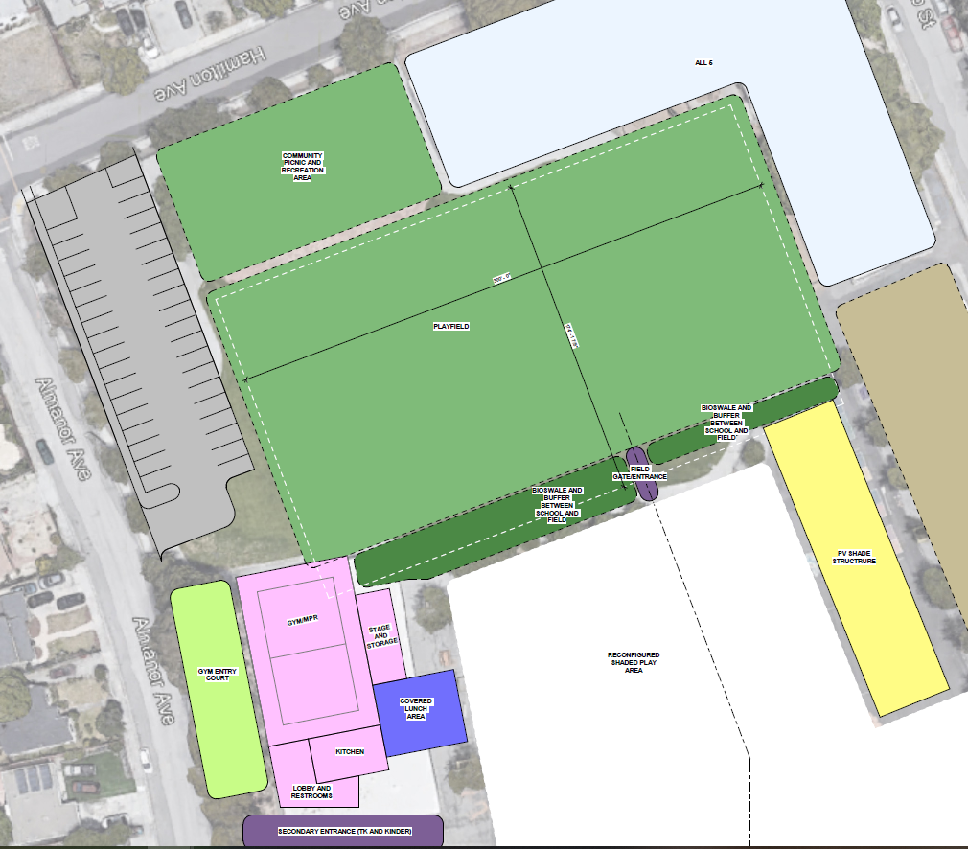
Preliminary Campus Design: Option 1 Our initial plan called for a new gym, additional parking, a community picnic area, a renovated turf field, a bio-swale divisor
Community picnic and recreation area with lots of trees
Expand the field by removing an older play structure
On site parking lot – not shown is the solar panels and publicly accessible EV chargers we plan on adding
New play area (brown) and PV structure (yellow)
New full size basketball gym with a community entrance (to the north) and a school entrance (to the south)
Newer basketball courts, a mini-pitch, and greenspace

Slide 7
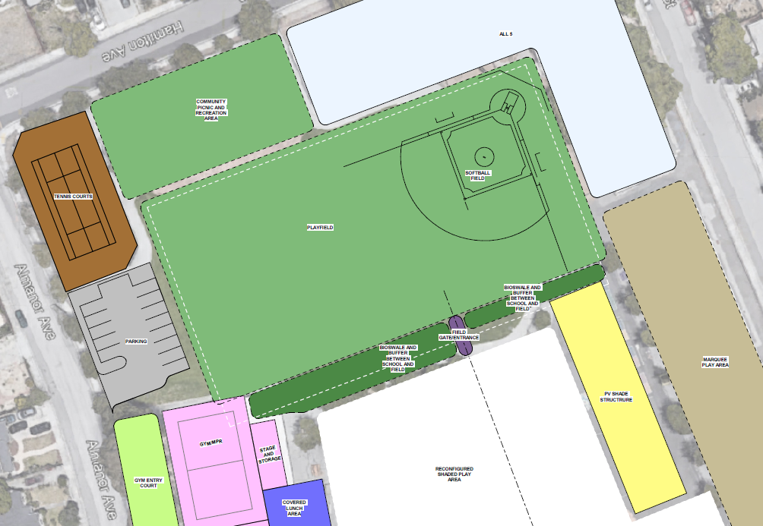
Preliminary Campus Design: Option 2 An alternative design could keep the tennis court and the tennis court
Keep the tennis court…
Keep a small baseball field
… shrink the parking lot

Slide 8
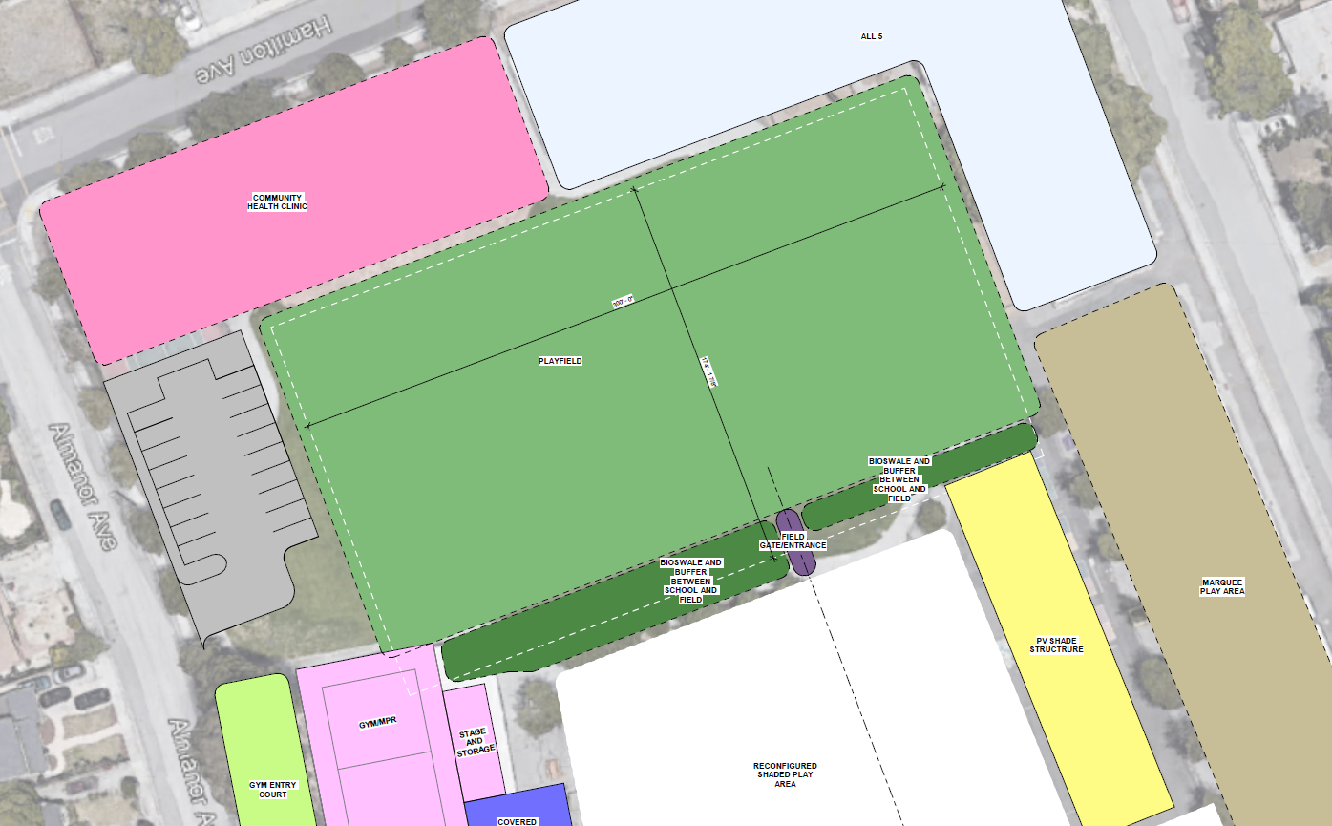
Preliminary Campus Design: Option 2 A third alternative design could add a community benefit building (e.g. a health clinic) on the northwest corner
Add a community benefit space (lose or relocate the picnic grove)
Community Benefit Space
The building could utilize a mid-sized parking lot

Slide 9
Next Steps Until construction begins of the field (and classrooms) begins in January of 2024, we can continue to tweak the designs
Timeline
Ways to Get Involved
2/23 - Board approves sequencing plan
Early March - Submit initial design to DSA
January, 2024 – Begin school site construction
Summer, 2026 – Conclude building construction, begin work on black top and fields
Fall-Summer, 2026-27 – Work on fields blacktop
Learn more on our website: http://www.ravenswoodschools.org/Choose-Ravenswood/Facilities/Belle-Haven-Redesign
Join one of our three upcoming in-person and online community events
Join us at tri-weekly in-person office hours
Give feedback through our (anonymous) on-line form
Come to one of our bi-weekly board meetings at 2120 Euclid (this project is discussed there monthly)
We’ll be back at the Parks Commission this Spring
Email Will to set-up a time to talk through the project or timeline
We’ve also done one Belle Haven-wide mailer and plan on doing another one – the project has also been covered in multiple newspaper articles

